Slide 1
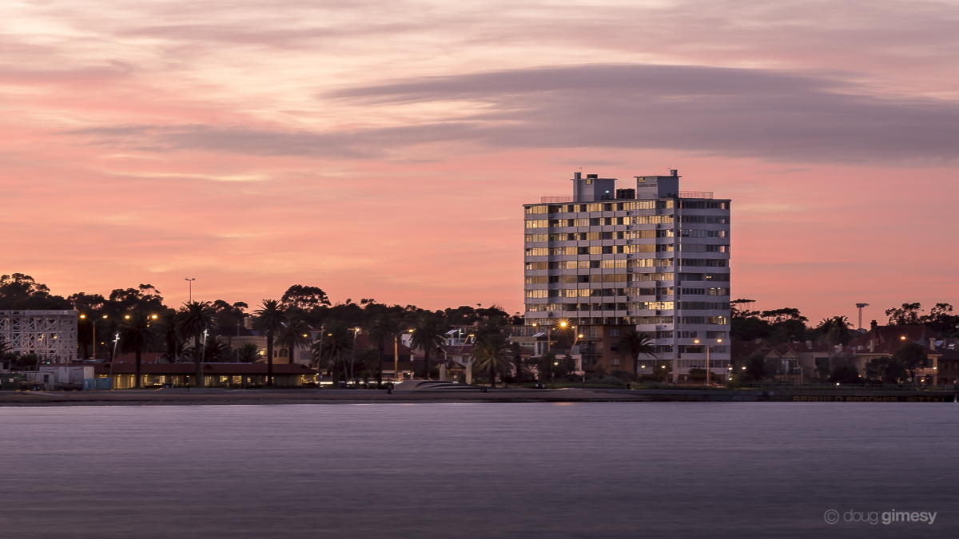
6. OC Chair’s Report
Image Credit: Doug Gimesy Conservation and Wildlife Photography

Slide 2
Committee Members 2022-23
Colin Trewern
Russell Jessop
John van der Laan
Mark Brickles
Michael Cass
Morgan Adams
Roger Hackworth
Ana Mikulic resigned during the year

Slide 3
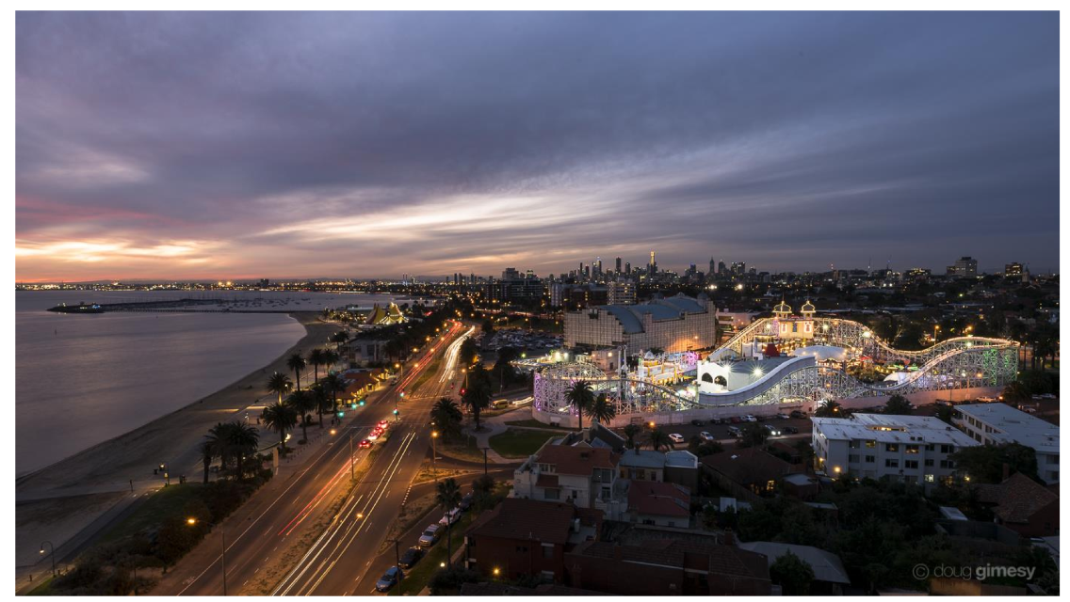
2018 AGM slide: NEW Vision for the lifts
Image Credit: Doug Gimesy Conservation and Wildlife Photography

Slide 4
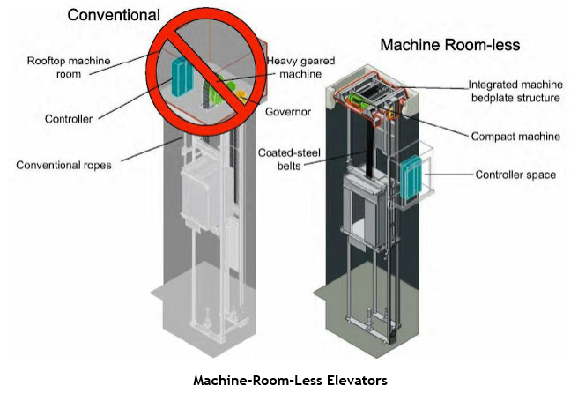
2018 AGM Slide: New Lift Technology
Removing the old Machine Room allows the lift to extend up to rooftop terrace
Roof

Slide 5
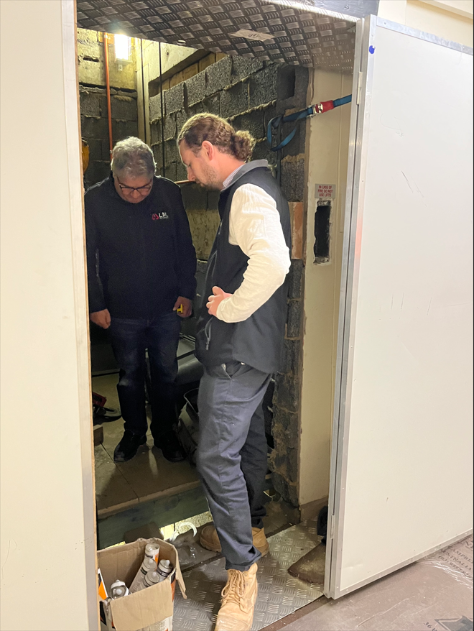
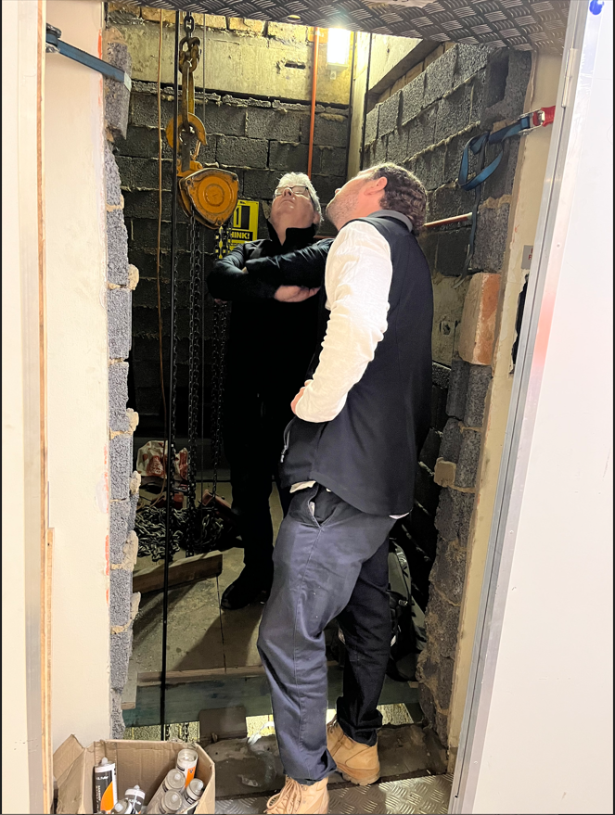
Temporary wood structural platform built inside the lift shaft at L12 to enable demolition of lift motor room concrete slab above.
4th November 2022 – Lift Consultant LML (Tony) Left & Builder Langcon (Jarrod) Right – Temporary platform.

Slide 6
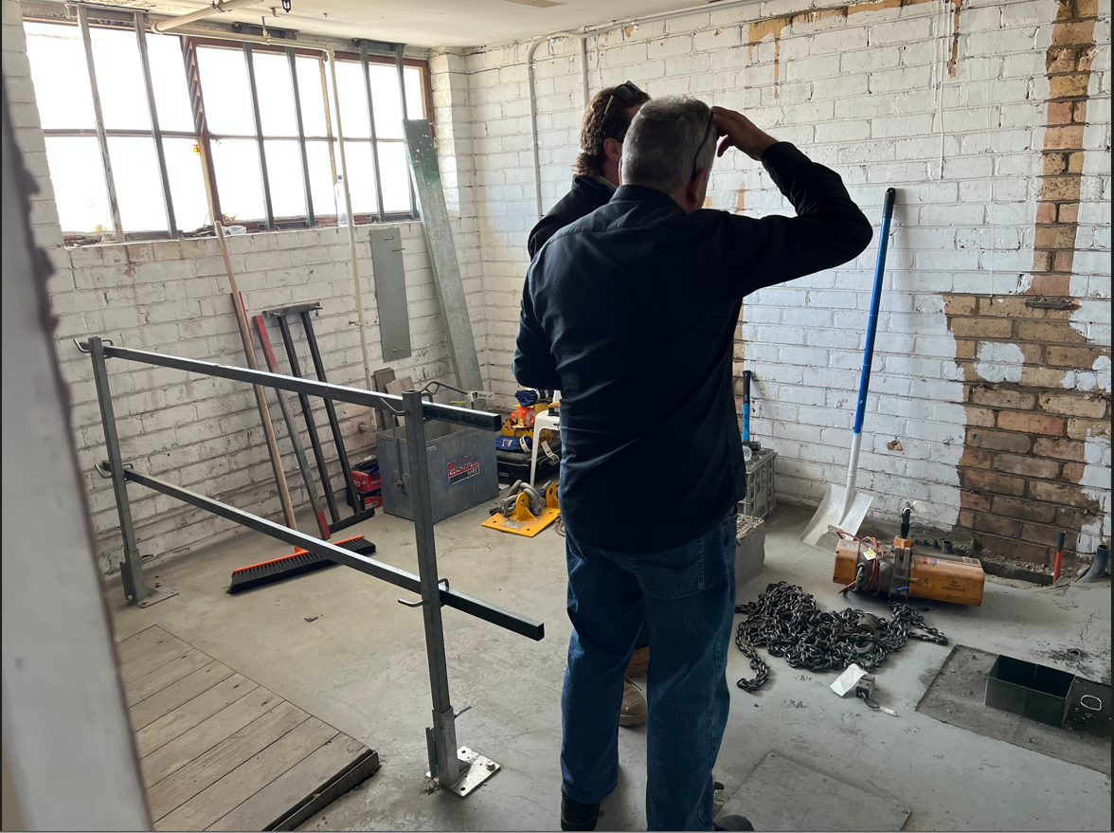
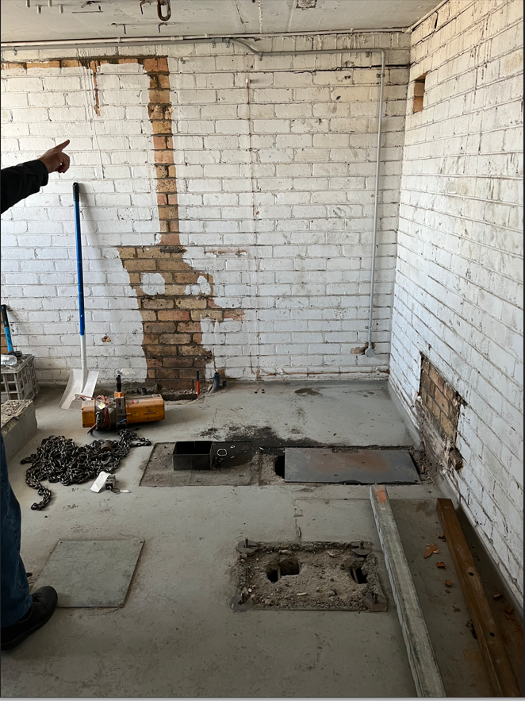
Future lift over-run
29th November 2022 – Old Lift Motor Room and machinery removed. Floor slab to be demolished for new lift shaft.

Slide 7
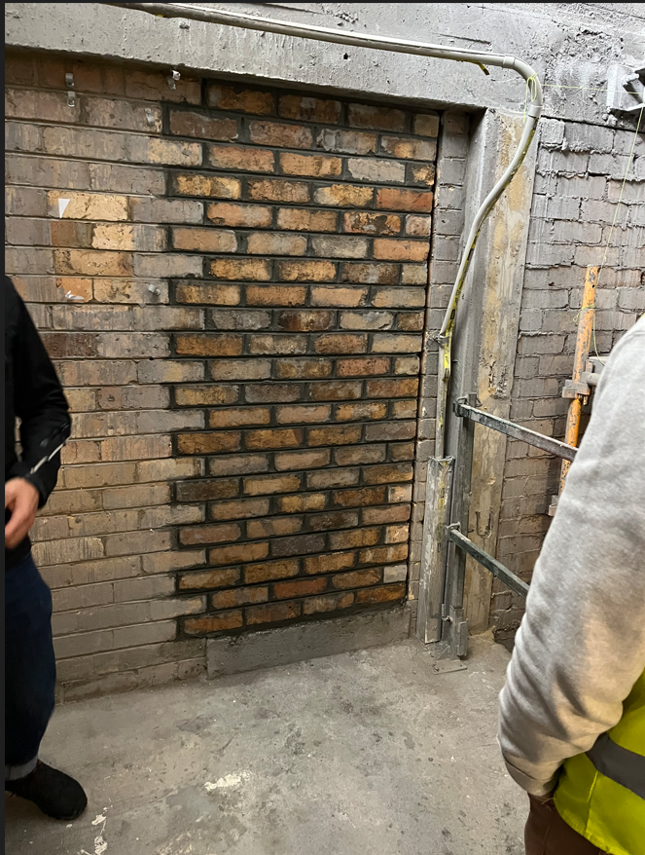
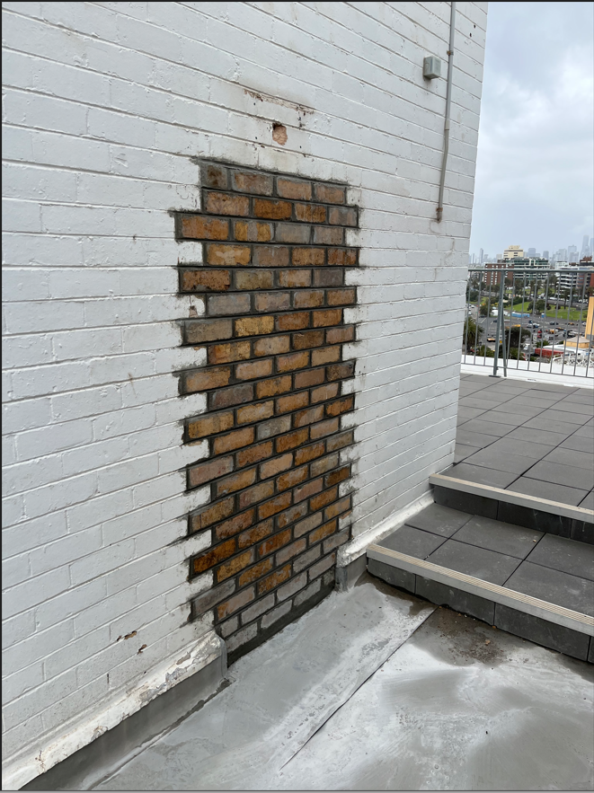
Future flat floor level
No steps
14th December 2022 – Old doorway bricked in prior to concrete beam removal and new doorway.

Slide 8
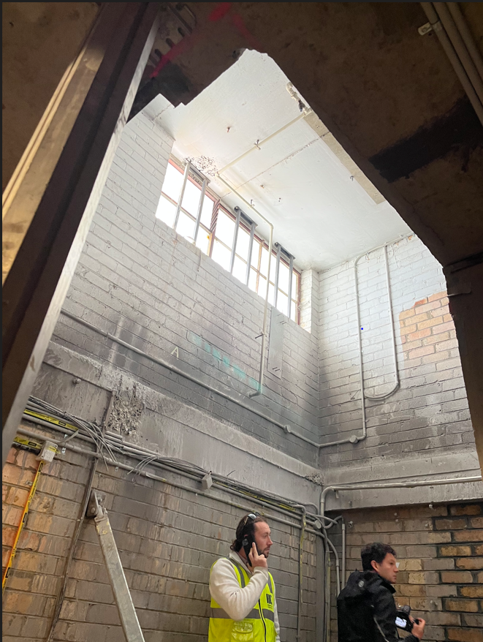
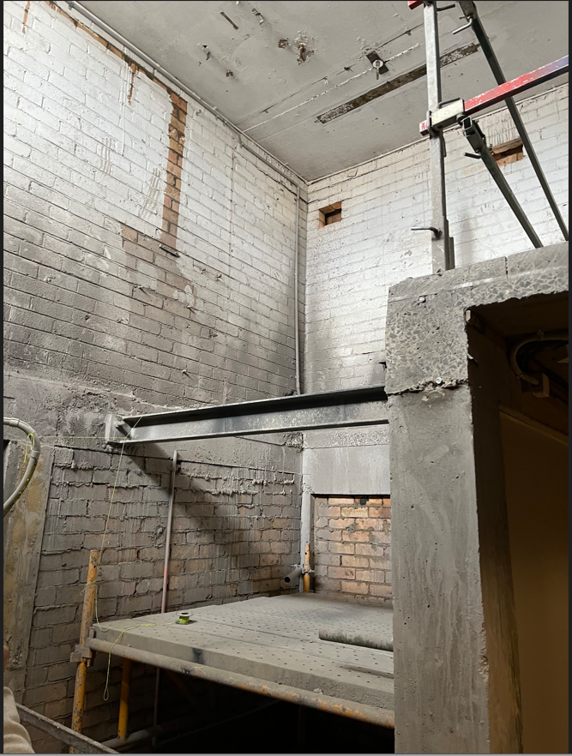
Future lift over-run
Future Doorway
Future lift shaft and lift door opening to new roof level
14th December 2022 – Old lift motor room concrete slab demolished and new structure.

Slide 9
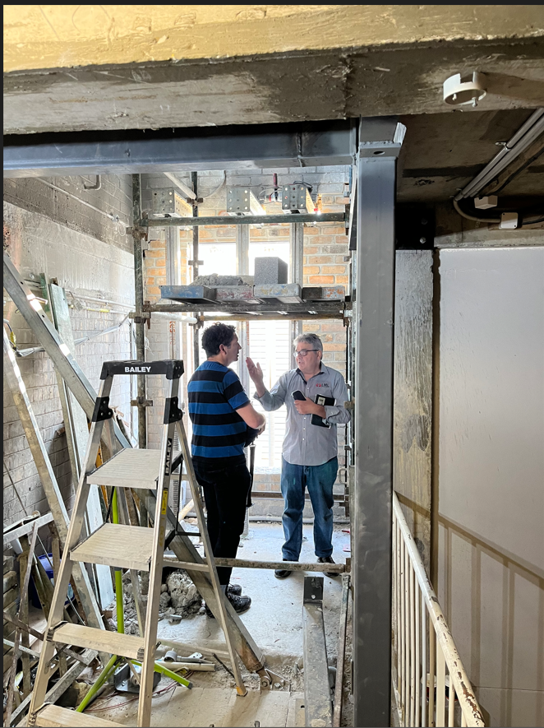
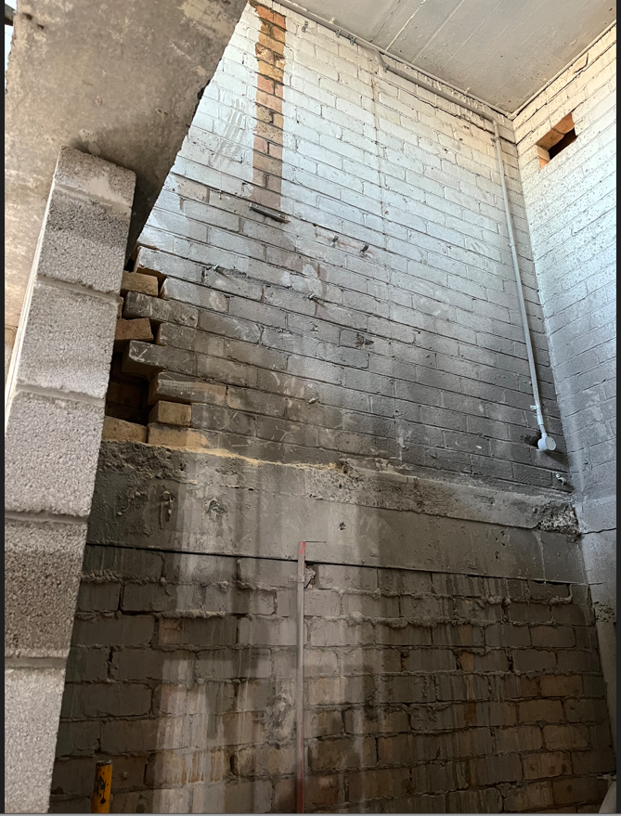
New cast concrete beams
New blockwork walls
New structural steelwork
22nd February 2023 – New structural steelwork. New concrete structure and blockwork lift shaft wall.

Slide 10
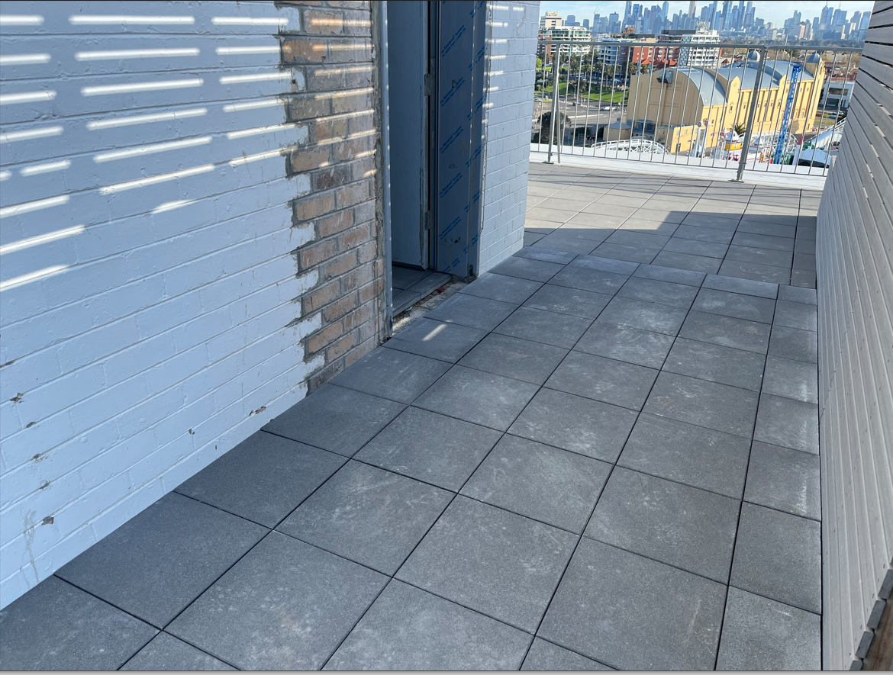
12th September 2023 – New flat floor access to rooftop terrace.

Slide 11
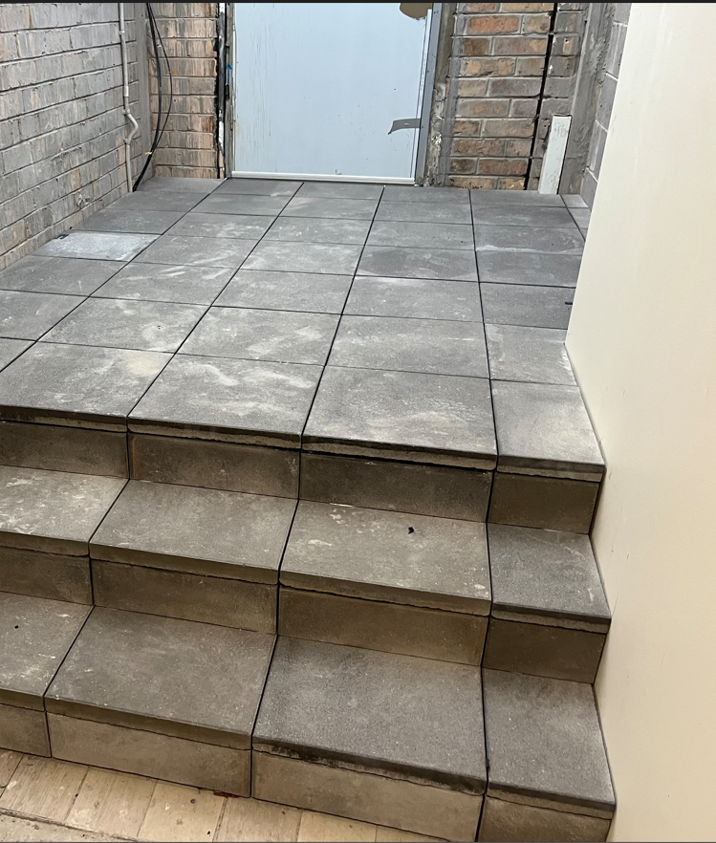
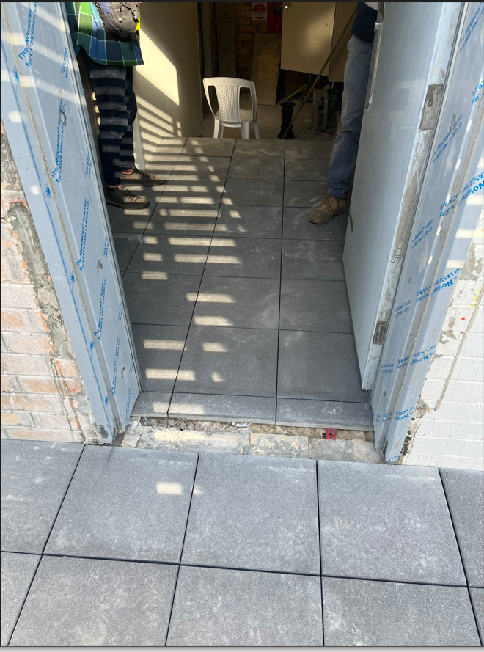
12th September 2023 – New doorway. New additional three steps from stairwell.

Slide 12
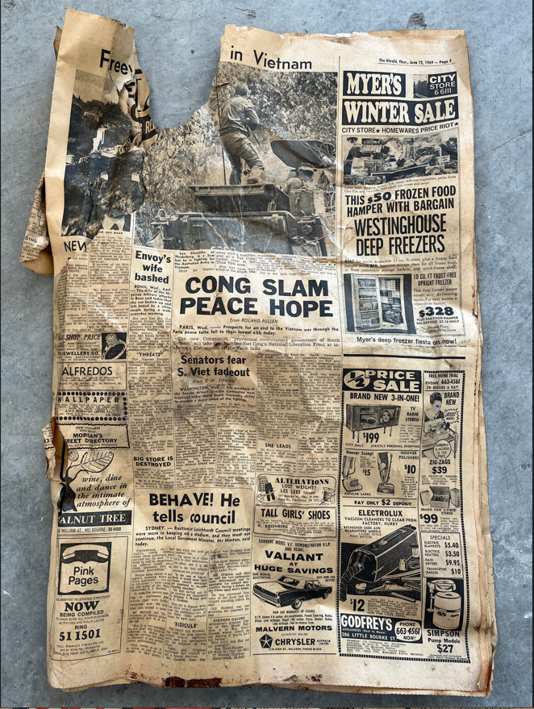
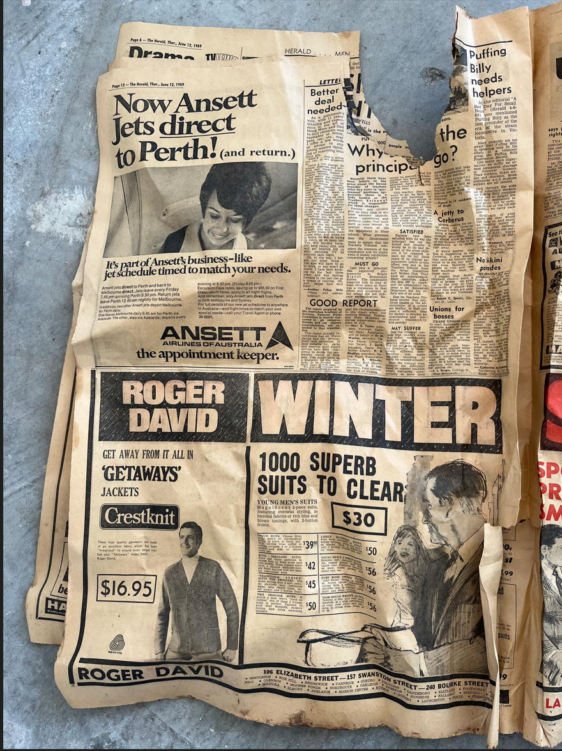
Ansett went into Administration 2001
Vietnam War ended 1975
Found inside the lift shaft: The Herald Newspaper, June 12th 1969
News of that day: “CONG SLAM PEACE HOPE - Prospects for an end to the Vietnam war through the Paris peace talks fell to their lowest ebb today” and “Now Ansett Jets direct to Perth”.

Slide 13
Façade Remediation
Colin Trewern & Roger Hackworth have started the preliminary investigation.
This was a major undertaking, and on behalf of all of us, I want to thank them.

Slide 14
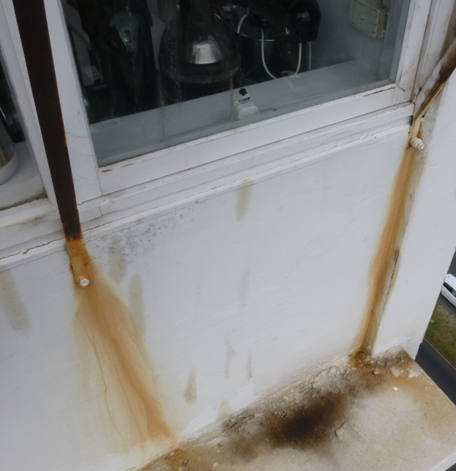
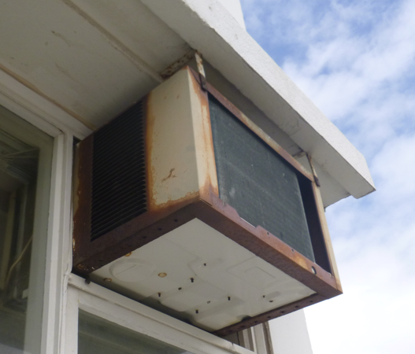
Repairs Needed ?

Slide 15
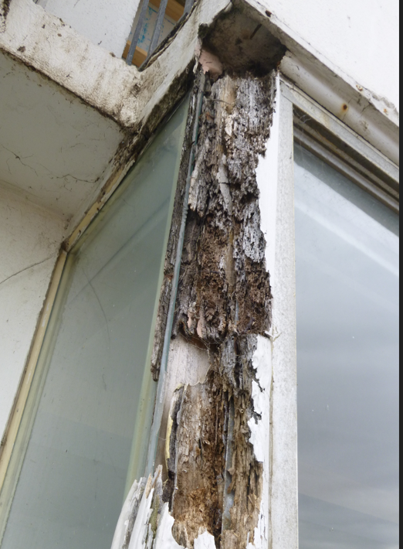
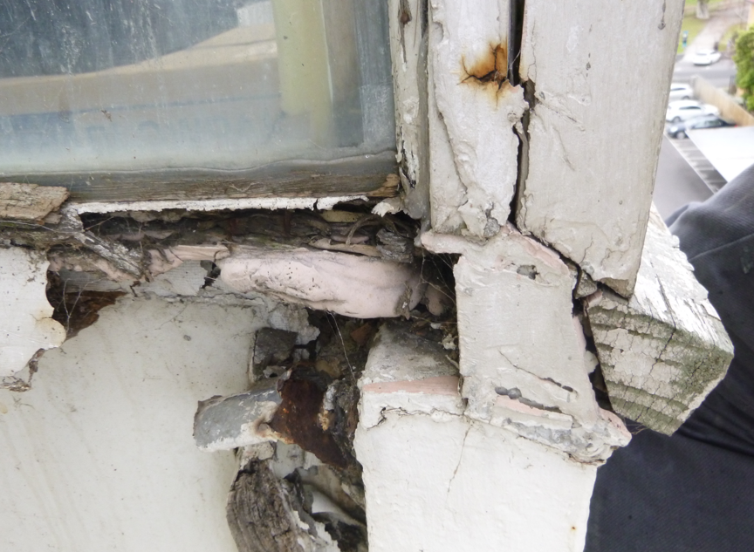
Repairs Needed ?

Slide 16
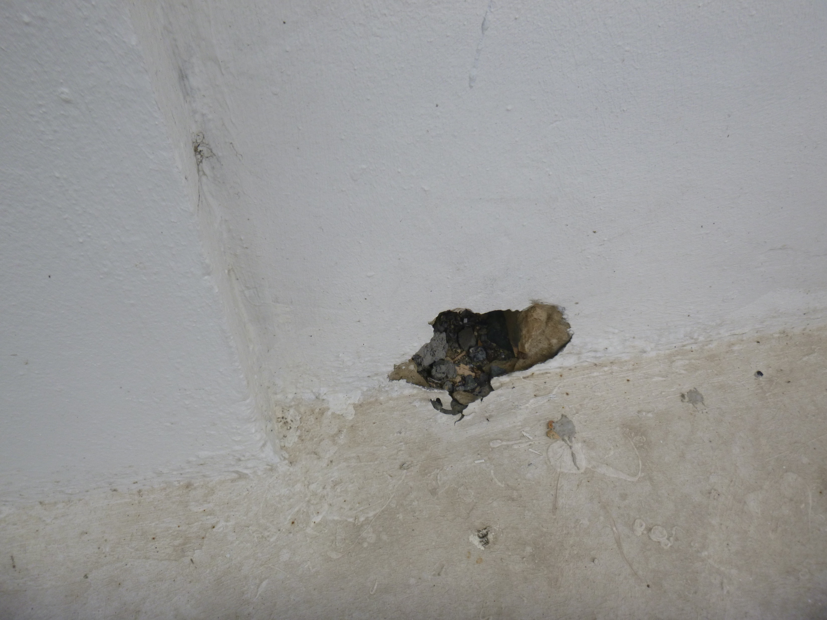
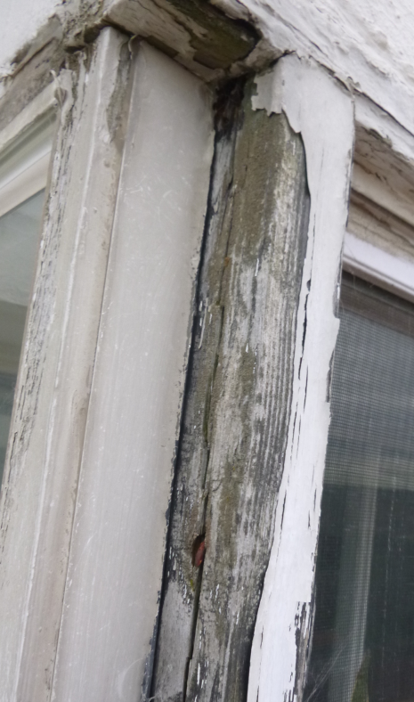
Repairs Needed ?

